Slide 1
Shapley Values: Easy, Useful & Intuitive
2018 Sawtooth Software Conference
Orlando, FL March 7, 2018
David W. Lyon
Principal
Aurora Market Modeling, LLC
11

Slide 2
Shapley Values
x
A useful way of summarizing and understanding any analysis that evaluates combinations of items
Not just TURF, not just KDRs, but all sorts of things
Not self-contained, but built on top of some other underlying analysis
A way of shifting the focus from combinations to items
Zillions of combinations, few enough items to actually deal with
A shift that is usually (not always) helpful to clients

Slide 3
The Plan
Intuitive
Key driver regressions – easy intuition about orderings
From orderings to combinations and sizes
Useful
Summary power
Easy
Computational Strategies
A Tangent: TURF on MaxDiff

Slide 4

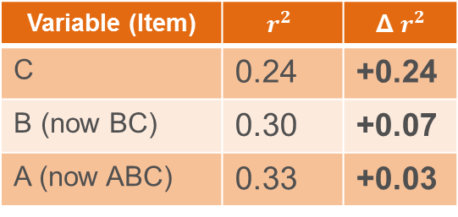
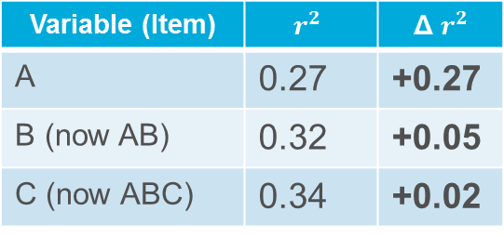
Key Driver Regressions
KDRs regress some overall measure on individual feature/item ratings. Key question: which features matter, how much?
Simple-minded answer – measure feature importance by how much the regression $r^{2}$ goes up when we add that variable.
Variable (Item) | $$r^{2}$$ | Δ $r^{2}$
A | 0.27 | +0.27
B (now AB) | 0.32 | +0.05
C (now ABC) | 0.34 | +0.02
Variable (Item) | $$r^{2}$$ | Δ $r^{2}$
C | 0.24 | +0.24
B (now BC) | 0.30 | +0.07
A (now ABC) | 0.33 | +0.03
But, order matters! How to choose the right order?

Slide 5

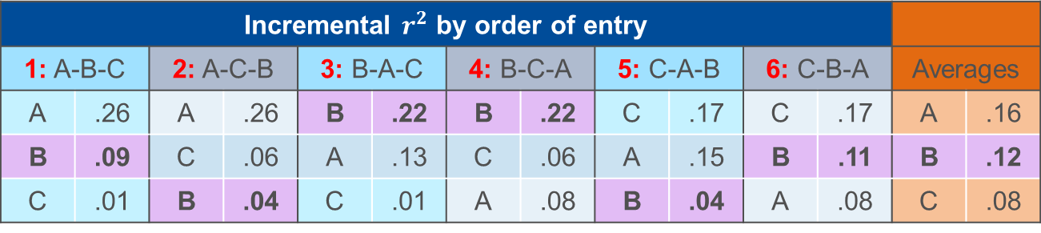
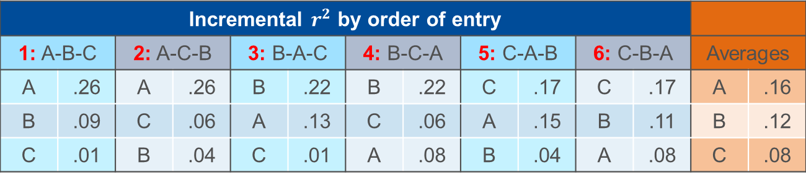
Averaging Over Orderings (“AOO”)
x
Order matters; we can’t just arbitrarily pick one. So,
Average over all possible orderings!
Popularized by William Kruskal (1987) with slightly different criterion than $r^{2}$.
Commonly known as “Shapley Value regression” or “Kruskal relative importance.”
Intuitively appealing and “fair.”
Incremental $r^{2}$ by order of entry
1: A-B-C |  | 2: A-C-B |  | 3: B-A-C |  | 4: B-C-A |  | 5: C-A-B |  | 6: C-B-A |  | Averages
A | .26 | A | .26 | B | .22 | B | .22 | C | .17 | C | .17 | A | .16
B | .09 | C | .06 | A | .13 | C | .06 | A | .15 | B | .11 | B | .12
C | .01 | B | .04 | C | .01 | A | .08 | B | .04 | A | .08 | C | .08
Incremental $r^{2}$ by order of entry
1: A-B-C |  | 2: A-C-B |  | 3: B-A-C |  | 4: B-C-A |  | 5: C-A-B |  | 6: C-B-A |  | Averages
A | .26 | A | .26 | B | .22 | B | .22 | C | .17 | C | .17 | A | .16
B | .09 | C | .06 | A | .13 | C | .06 | A | .15 | B | .11 | B | .12
C | .01 | B | .04 | C | .01 | A | .08 | B | .04 | A | .08 | C | .08

Slide 6
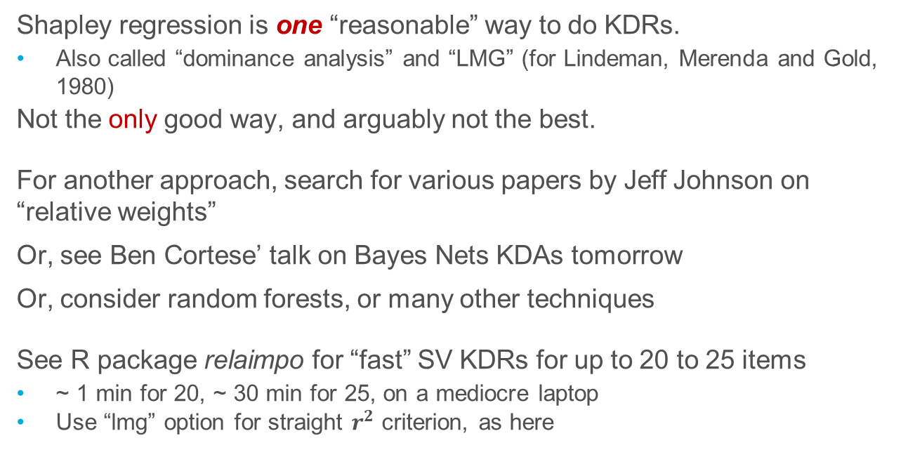
Side Notes About KDRs
Shapley regression is one “reasonable” way to do KDRs.
Also called “dominance analysis” and “LMG” (for Lindeman, Merenda and Gold, 1980)
Not the only good way, and arguably not the best.
For another approach, search for various papers by Jeff Johnson on “relative weights”
Or, see Ben Cortese’ talk on Bayes Nets KDAs tomorrow
Or, consider random forests, or many other techniques
See R package relaimpo for “fast” SV KDRs for up to 20 to 25 items
~ 1 min for 20, ~ 30 min for 25, on a mediocre laptop
Use “lmg” option for straight $r^{2}$ criterion, as here

Slide 7
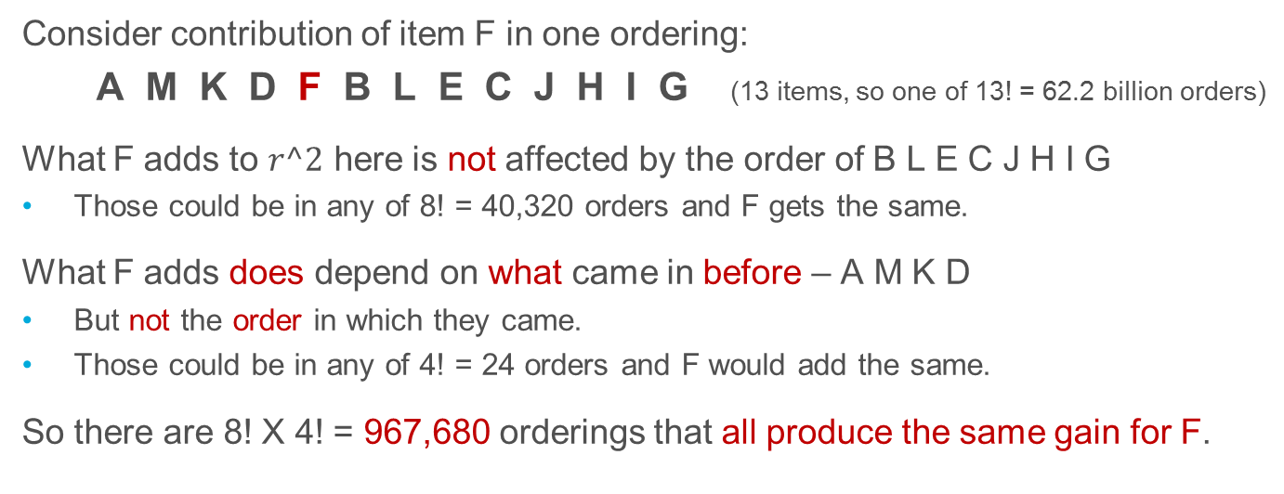
Orderings? What About Combinations?
x
Consider contribution of item F in one ordering:
A M K D F B L E C J H I G (13 items, so one of 13! = 62.2 billion orders)
What F adds to $r^2$ here is not affected by the order of B L E C J H I G
Those could be in any of 8! = 40,320 orders and F gets the same.
What F adds does depend on what came in before – A M K D
But not the order in which they came.
Those could be in any of 4! = 24 orders and F would add the same.
So there are 8! X 4! = 967,680 orderings that all produce the same gain for F.
{ A M K D }

Slide 8
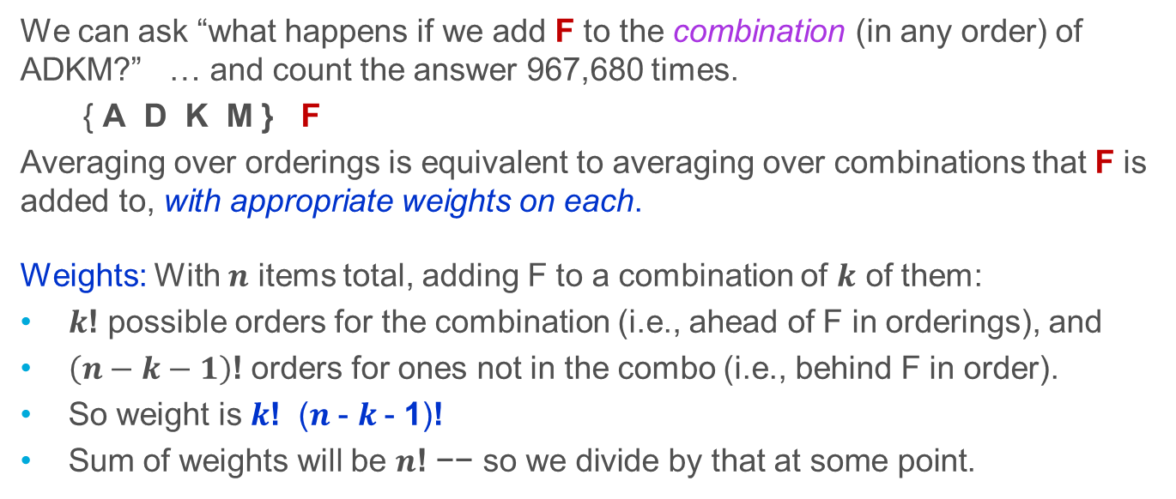
Recasting as Combinations
We can ask “what happens if we add F to the combination (in any order) of ADKM?” … and count the answer 967,680 times.
{ A D K M } F
Averaging over orderings is equivalent to averaging over combinations that F is added to, with appropriate weights on each.
Weights: With $n$ items total, adding F to a combination of $k$ of them:
$k$! possible orders for the combination (i.e., ahead of F in orderings), and
$\left(n−k−1\right)\text{!}$ orders for ones not in the combo (i.e., behind F in order).
So weight is $k\text{!}$ ($n$- $k$- 1)$\text{!}$
Sum of weights will be $n\text{!} \text{−− }\text{so} \text{we} \text{divide} \text{by} \text{that} \text{at} \text{some} \text{point}\text{.}$

Slide 9
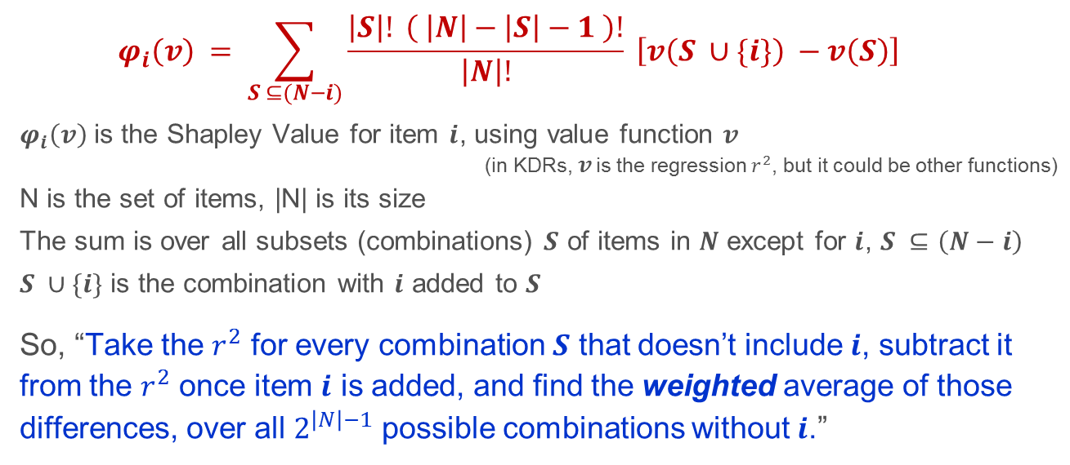

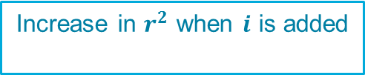

Shapley Values As Averages Over Combinations
SV for item $i$, using value function
$v$ (e.g., $r^{2}$)
Wt: # of orderings in which this combo occurs
$$φ_{i}\left(v\right) = \sum_{S ⊆(N−i)}{\frac{\left|S\right|! \left( \left|N\right|−\left|S\right|−1 \right)!}{\left|N\right|!} \left[v\left(S ∪\{i\}\right) −v\left(S\right)\right]}$$
$φ_{i}\left(v\right)$is the Shapley Value for item $i$, using value function $v$
(in KDRs, $v$ is the regression $r^{2}$, but it could be other functions)
N is the set of items, |N| is its size
The sum is over all subsets (combinations) $S$ of items in $N$ except for $i$, $S ⊆\left(N−i\right)$
$S ∪\{i\}$ is the combination with $i$ added to $S$
So, “Take the $r^{2}$ for every combination $S$ that doesn’t include $i$, subtract it from the $r^{2}$ once item $i$ is added, and find the weighted average of those differences, over all $2^{\left|N\right|−1}$ possible combinations without $i$.”
Increase in $r^{2}$ when $i$ is added
${ r}^{2}$ for items in $S$

Slide 10
Ways To Go Wrong …. Weighting Matters!
x
By size of combination, 0 to 19 (before adding)
Number of combinations
(unweighted puts most
weight in the middle)
Combos size 6 to 13 account for most
Weights per combination
(can’t ignore how many each
weight applies to)
Just adding the 20 weights suggests 90%+ at the two ends …. ??? Wrong!
Net # combos X weights
(each combo size
counts equally)

Slide 11
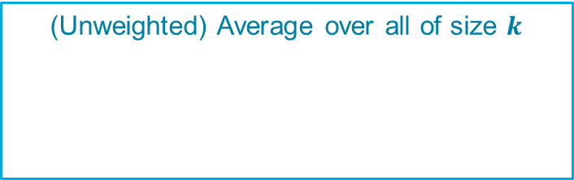
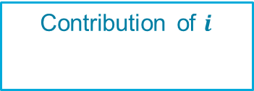
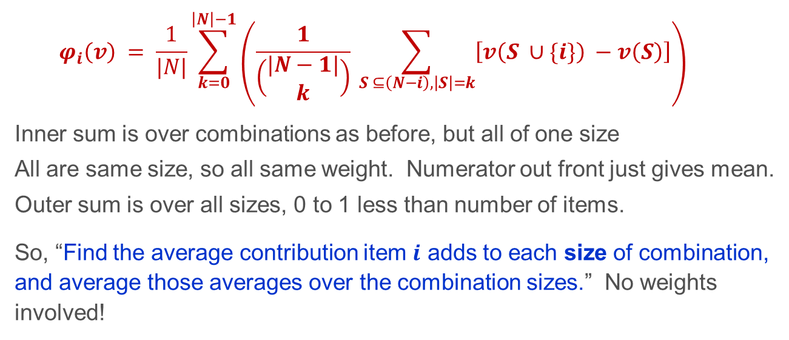
Shapley Values Averaged Over Combo Sizes
(Unweighted) Average over sizes
(Unweighted) Average over all of size $k$
$$φ_{i}\left(v\right) = \frac{1}{|N|}\sum_{k=0}^{\left|N\right|−1}{\left(\frac{1}{\left(\begin{matrix}|N−1| \\ k\end{matrix}\right)} \sum_{S ⊆\left(N−i\right),\left|S\right|=k}{\left[v\left(S ∪\{i\}\right) −v\left(S\right)\right]}\right) }$$
Inner sum is over combinations as before, but all of one size
All are same size, so all same weight. Numerator out front just gives mean.
Outer sum is over all sizes, 0 to 1 less than number of items.
So, “Find the average contribution item $i$ adds to each size of combination, and average those averages over the combination sizes.” No weights involved!
Contribution of $i$

Slide 12
Intuition
Shapley Values are gains as we step through all items
Averaged over all possible orderings
Useful when thinking about all items, as in KDRs
SVs are gains when an item is added to a combination it’s not in
Averaged over all possible combinations, with appropriate weights
SVs are gains when an item is added to a combination it’s not in
With all sizes of initial combinations counting equally
Useful when thinking about combinations, as in TURFs

Slide 13

TURF – Total Unduplicated Reach & Frequency
Item | “Reach” (or “Hit”)
Flavor or variety | Would buy
Message | Important/believe
Feature | Want it
Many variations …
“Unduplicated reach” – percentage of
respondents “reached” by at least one
item in a combination (frequency is ignored!)
Respondent data is 0-1 for each item:
1=would buy, believe or want, 0=not so.
Question is “What’s the best [i.e., greatest reach] combination of $k$ items?” for various values of $k$
Important variant: “depths” – reached by at least <depth> items in a combo
Depth 1
Good item pair extends breadth; depth>1 is wasted
Depth 2
Good item pair increases depth; depth<2 is wasted

Slide 14
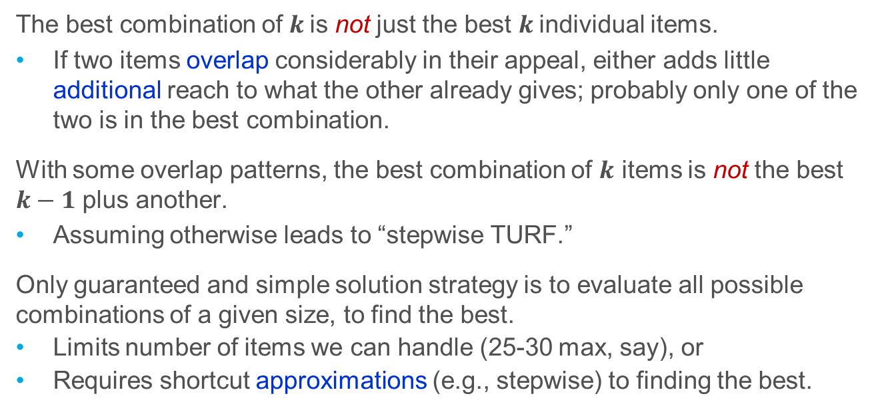
TURF Can Be Challenging
The best combination of $k$is not just the best $k$individual items.
If two items overlap considerably in their appeal, either adds little additional reach to what the other already gives; probably only one of the two is in the best combination.
With some overlap patterns, the best combination of $k$ items is not the best $k−1$ plus another.
Assuming otherwise leads to “stepwise TURF.”
Only guaranteed and simple solution strategy is to evaluate all possible combinations of a given size, to find the best.
Limits number of items we can handle (25-30 max, say), or
Requires shortcut approximations (e.g., stepwise) to finding the best.

Slide 15
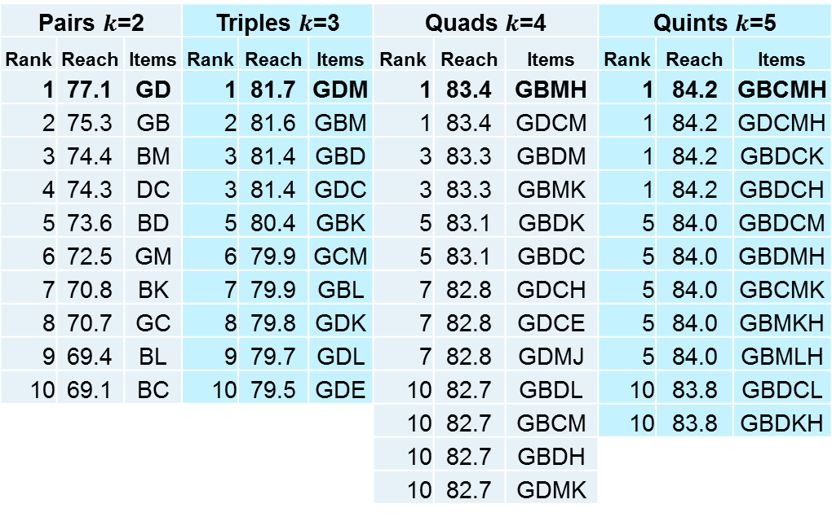
Typical TURF Results ….
Top row is the literal answer to “What’s the best?”
The rest is mind-numbingly dull!
Are there “insights” here?
And this is for a single depth!
Pairs $k$=2 |  |  | Triples $k$=3 |  |  | Quads $k$=4 |  |  | Quints $k$=5
Rank | Reach | Items | Rank | Reach | Items | Rank | Reach | Items | Rank | Reach | Items
1 | 77.1 | GD | 1 | 81.7 | GDM | 1 | 83.4 | GBMH | 1 | 84.2 | GBCMH
2 | 75.3 | GB | 2 | 81.6 | GBM | 1 | 83.4 | GDCM | 1 | 84.2 | GDCMH
3 | 74.4 | BM | 3 | 81.4 | GBD | 3 | 83.3 | GBDM | 1 | 84.2 | GBDCK
4 | 74.3 | DC | 3 | 81.4 | GDC | 3 | 83.3 | GBMK | 1 | 84.2 | GBDCH
5 | 73.6 | BD | 5 | 80.4 | GBK | 5 | 83.1 | GBDK | 5 | 84.0 | GBDCM
6 | 72.5 | GM | 6 | 79.9 | GCM | 5 | 83.1 | GBDC | 5 | 84.0 | GBDMH
7 | 70.8 | BK | 7 | 79.9 | GBL | 7 | 82.8 | GDCH | 5 | 84.0 | GBCMK
8 | 70.7 | GC | 8 | 79.8 | GDK | 7 | 82.8 | GDCE | 5 | 84.0 | GBMKH
9 | 69.4 | BL | 9 | 79.7 | GDL | 7 | 82.8 | GDMJ | 5 | 84.0 | GBMLH
10 | 69.1 | BC | 10 | 79.5 | GDE | 10 | 82.7 | GBDL | 10 | 83.8 | GBDCL
 |  |  |  |  |  | 10 | 82.7 | GBCM | 10 | 83.8 | GBDKH
 |  |  |  |  |  | 10 | 82.7 | GBDH
 |  |  |  |  |  | 10 | 82.7 | GDMK
Imagine 20+ items, up to k=10+, several depths!

Slide 16
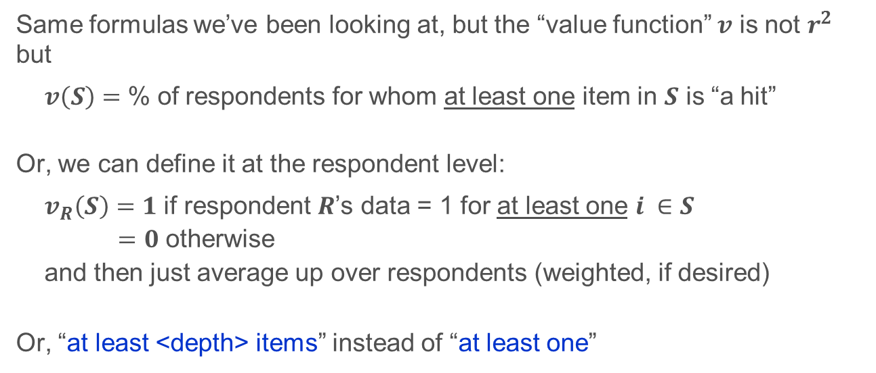
Applying Shapley Values to TURF
Same formulas we’ve been looking at, but the “value function” $v$ is not $r^{2}$ but
$v\left(S\right)=$ % of respondents for whom at least one item in $S$ is “a hit”
Or, we can define it at the respondent level:
$v_{R}\left(S\right)=1$ if respondent $R$’s data = 1 for at least one $i ∈S$
$=0$ otherwise
and then just average up over respondents (weighted, if desired)
Or, “at least <depth> items” instead of “at least one”

Slide 17
Typical Shapley Values for TURF
Shapley Values:
Standard TURF (depth 1) | TURF depth 2 | TURF depth 3 | Information Source
13.8 | 11.8 | 11.4 | G | In-person sales rep visit
13.8 | 13.2 | 12.8 | B | Informative snail mail
11.7 | 11.7 | 10.7 | D | Emails, E-newsletters
11.6 | 10.8 | 10.8 | C | Leaflet/brochure in snail mail
8.0 | 8.0 | 8.0 | A | Website
7.1 | 6.9 | 6.4 | M | Smartphone apps
4.8 | 4.4 | 4.4 | K | Self-guided online programs
4.4 | 4.4 | 4.2 | L | Reminder/alert/pop-up on <xxx>
4.3 | 3.9 | 3.4 | H | Live talk with tech experts
1.9 | 1.9 | 1.9 | E | Texts from company
1.4 | 1.4 | 1.2 | J | Live-assisted online programs
1.4 | 1.4 | 1.4 | F | Phone call from sales rep
0.9 | 0.9 | 0.9 | I | Robo calls
(Same data as “Typical TURF Results” slide, but with 3 depths now.)
This is complete, and informative!
Easy to see G and B are close, D and C close behind, rest further back, and other actual “insights.”
It’s a “road map” to the TURF.
BUT, does not answer “Which is
the one best combo?”
Sample of 300 physicians surveyed re pharma co. communication channels

Slide 18
Typical TURF Results ….
Partial, for just one depth!
Pairs $k$=2 |  |  | Triples $k$=3 |  |  | Quads $k$=4 |  |  | Quints $k$=5
Rank | Reach | Items | Rank | Reach | Items | Rank | Reach | Items | Rank | Reach | Items
1 | 77.1 | GD | 1 | 81.7 | GDM | 1 | 83.4 | GBMH | 1 | 84.2 | GBCMH
2 | 75.3 | GB | 2 | 81.6 | GBM | 1 | 83.4 | GDCM | 1 | 84.2 | GDCMH
3 | 74.4 | BM | 3 | 81.4 | GBD | 3 | 83.3 | GBDM | 1 | 84.2 | GBDCK
4 | 74.3 | DC | 3 | 81.4 | GDC | 3 | 83.3 | GBMK | 1 | 84.2 | GBDCH
5 | 73.6 | BD | 5 | 80.4 | GBK | 5 | 83.1 | GBDK | 5 | 84.0 | GBDCM
6 | 72.5 | GM | 6 | 79.9 | GCM | 5 | 83.1 | GBDC | 5 | 84.0 | GBDMH
7 | 70.8 | BK | 7 | 79.9 | GBL | 7 | 82.8 | GDCH | 5 | 84.0 | GBCMK
8 | 70.7 | GC | 8 | 79.8 | GDK | 7 | 82.8 | GDCE | 5 | 84.0 | GBMKH
9 | 69.4 | BL | 9 | 79.7 | GDL | 7 | 82.8 | GDMJ | 5 | 84.0 | GBMLH
10 | 69.1 | BC | 10 | 79.5 | GDE | 10 | 82.7 | GBDL | 10 | 83.8 | GBDCL
 |  |  |  |  |  | 10 | 82.7 | GBCM | 10 | 83.8 | GBDKH
 |  |  |  |  |  | 10 | 82.7 | GBDH
 |  |  |  |  |  | 10 | 82.7 | GDMK

Slide 19
Better than TURF, Or Just A Different View?
x
SVs are more compact, easier to present and think about, than raw TURF.
SVs are more stable (cross-wave, cross-subgroup comparisons)
They aren’t rankings, but ratio-scaled averages
What about combos of items with the highest Shapley Values?
Not the same as true best combination
Claims sometimes made for them do not hold up in general
SVs are more compact, easier to present and think about, than raw TURF.
And more stable

Slide 20
The Computational Elephant
With 20 items, it takes a while to evaluate the 1 million+ combos involved. With 25-30, you work really hard. Beyond that, forget it!
But we can sometimes do a direct, easy, exact, ultra-fast computation
At the respondent level!
For some value functions (including TURF and variants/relatives)

Slide 21
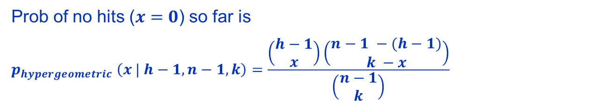

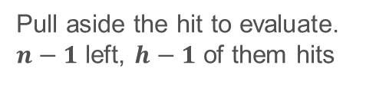


SVs from TURF, at the Respondent Level
x
●
$n$ items
$h$ of them are “hits” for a given
respondent
Have a combo of size $k$
What happens if we add:
A nonhit? Nothing
A hit?
+1, IFF no other hits yet
0, if another hit among the $k$
$n$ = 6 $h$ = 2
○
○
Pull aside the hit to evaluate.
$n−1$ left, $h−1$ of them hits
○
○
●
?
Say we have $k$ = 2 already
?
○
If then our item “scores the win,” +1
○
●
●
If then our item adds nothing.
○
What’s the chance of no hits in a combo of $k=2$?
Prob of no hits ($x=0$) so far is
$$p_{hypergeometric} \left(x | h−1, n−1, k\right)=\frac{\left(\begin{matrix}h−1 \\ x\end{matrix}\right)\left(\begin{matrix}n−1 −(h−1) \\ k −x\end{matrix}\right)}{\left(\begin{matrix}n−1 \\ k\end{matrix}\right)}$$

Slide 22
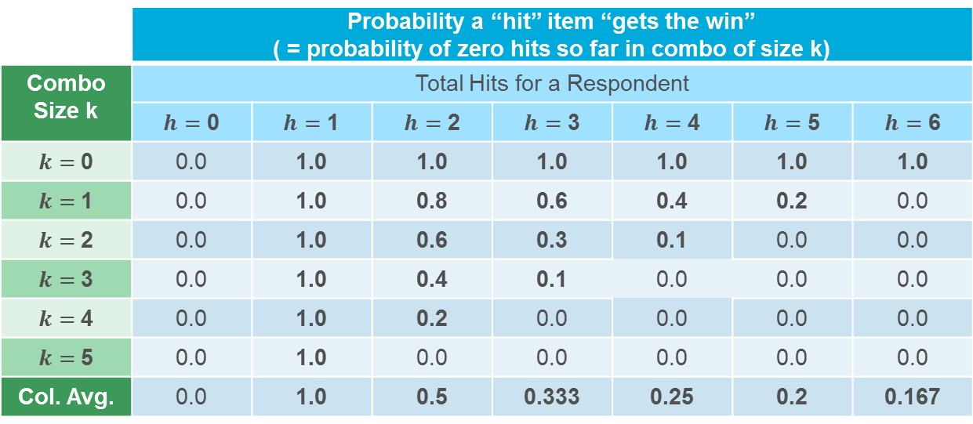



SVs for TURF at the Respondent Level
Example for $n=6$ items total. $x=0$
 | Probability a “hit” item “gets the win” ( = probability of zero hits so far in combo of size k)
Combo Size k | Total Hits for a Respondent
 | $h=$ 0 | $h=$ 1 | $h=$ 2 | $h=$ 3 | $h=$ 4 | $h=$ 5 | $h=$ 6
$k=$0 | 0.0 | 1.0 | 1.0 | 1.0 | 1.0 | 1.0 | 1.0
$k=$1 | 0.0 | 1.0 | 0.8 | 0.6 | 0.4 | 0.2 | 0.0
$k=$2 | 0.0 | 1.0 | 0.6 | 0.3 | 0.1 | 0.0 | 0.0
$k=$3 | 0.0 | 1.0 | 0.4 | 0.1 | 0.0 | 0.0 | 0.0
$k=$4 | 0.0 | 1.0 | 0.2 | 0.0 | 0.0 | 0.0 | 0.0
$k=$5 | 0.0 | 1.0 | 0.0 | 0.0 | 0.0 | 0.0 | 0.0
Col. Avg. | 0.0 | 1.0 | 0.5 | 0.333 | 0.25 | 0.2 | 0.167
$$\frac{\left(\begin{matrix}h−1 \\ x\end{matrix}\right)\left(\begin{matrix}n−1 −(h−1) \\ k −x\end{matrix}\right)}{\left(\begin{matrix}n−1 \\ k\end{matrix}\right)}$$
$$\frac{1}{h}$$

Slide 23
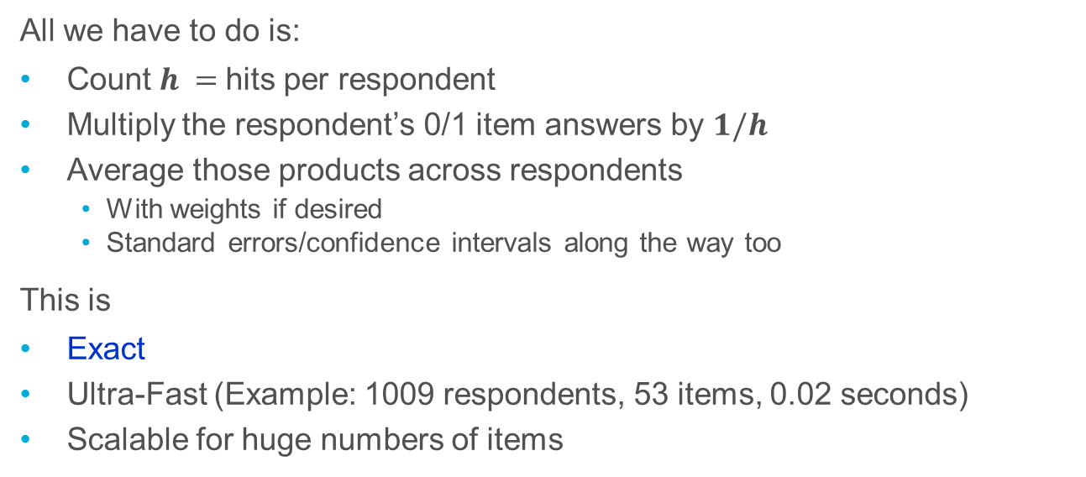
Exact Shapley Values via Respondent-Level TURF
All we have to do is:
Count $h =$hits per respondent
Multiply the respondent’s 0/1 item answers by $1/h$
Average those products across respondents
With weights if desired
Standard errors/confidence intervals along the way too
This is
Exact
Ultra-Fast (Example: 1009 respondents, 53 items, 0.02 seconds)
Scalable for huge numbers of items

Slide 24
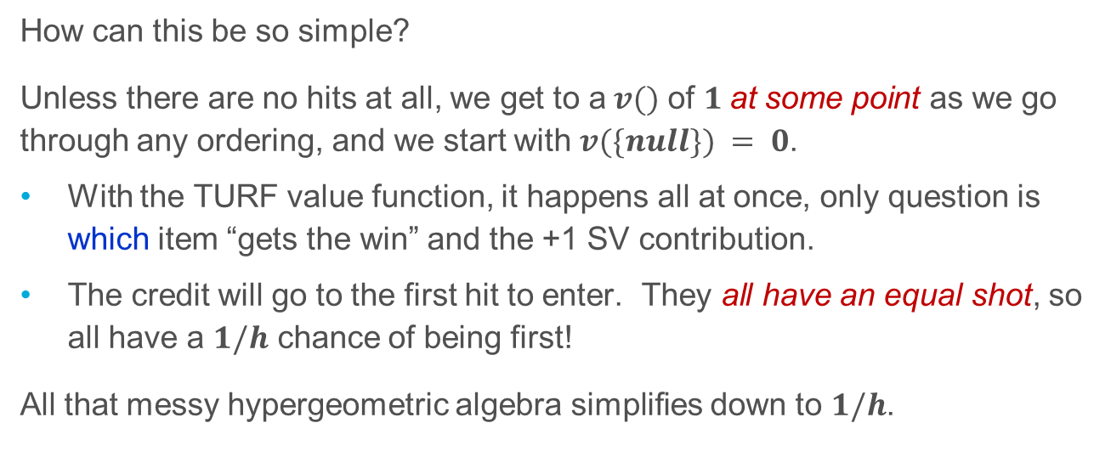

$1/h$ – Really?
TURF $v()$
Combination size
How can this be so simple?
Unless there are no hits at all, we get to a$v()$ of $1$at some point as we go through any ordering, and we start with $v(\{null\}) = 0$.
With the TURF value function, it happens all at once, only question is which item “gets the win” and the +1 SV contribution.
The credit will go to the first hit to enter. They all have an equal shot, so all have a $1/h$ chance of being first!
All that messy hypergeometric algebra simplifies down to $1/h$.

Slide 25
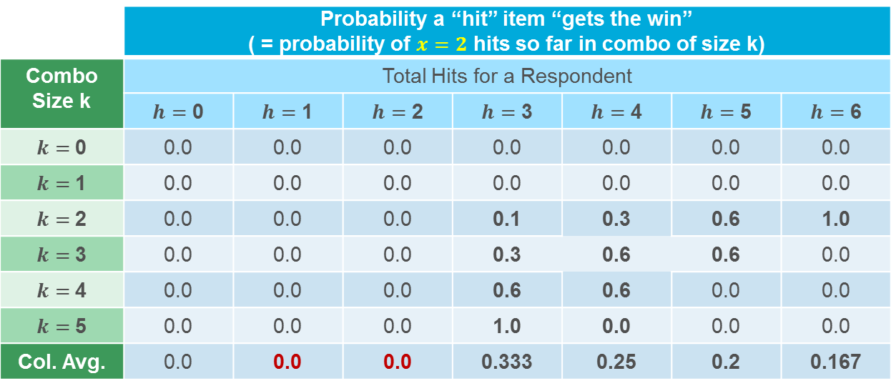


What About Other Depths?
Just set $x=depth−1. \text{In} \text{below}\text{, }depth=3,\text{so} x=2$
 | Probability a “hit” item “gets the win” ( = probability of $x=2$ hits so far in combo of size k)
Combo Size k | Total Hits for a Respondent
 | $h=$ 0 | $h=$ 1 | $h=$ 2 | $h=$ 3 | $h=$ 4 | $h=$ 5 | $h=$ 6
$k=$0 | 0.0 | 0.0 | 0.0 | 0.0 | 0.0 | 0.0 | 0.0
$k=$1 | 0.0 | 0.0 | 0.0 | 0.0 | 0.0 | 0.0 | 0.0
$k=$2 | 0.0 | 0.0 | 0.0 | 0.1 | 0.3 | 0.6 | 1.0
$k=$3 | 0.0 | 0.0 | 0.0 | 0.3 | 0.6 | 0.6 | 0.0
$k=$4 | 0.0 | 0.0 | 0.0 | 0.6 | 0.6 | 0.0 | 0.0
$k=$5 | 0.0 | 0.0 | 0.0 | 1.0 | 0.0 | 0.0 | 0.0
Col. Avg. | 0.0 | 0.0 | 0.0 | 0.333 | 0.25 | 0.2 | 0.167
$$\frac{\left(\begin{matrix}h−1 \\ x\end{matrix}\right)\left(\begin{matrix}n−1 −(h−1) \\ k −x\end{matrix}\right)}{\left(\begin{matrix}n−1 \\ k\end{matrix}\right)}$$
$$\frac{1}{h}$$
$Chance of \text{being}\text{ 3}\text{rd} is same as of \text{first}:1/h$ (unless only 1 or 2, so no 3rd).

Slide 26
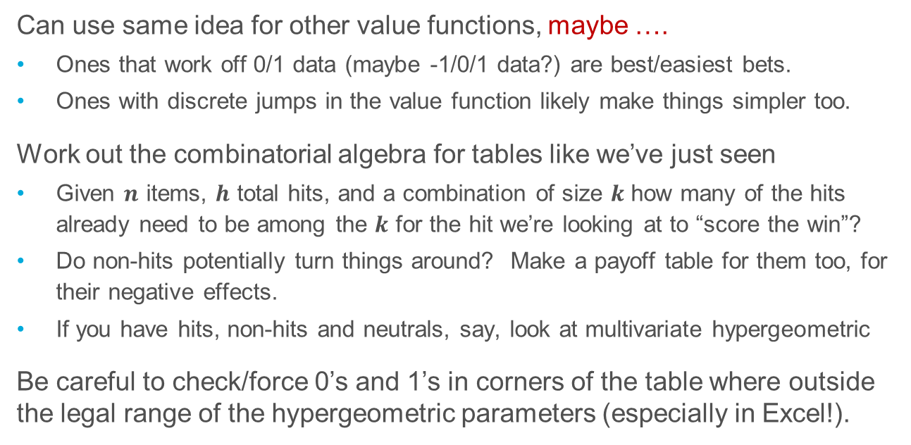
It’s Just for TURFs, Right? NO!
Can use same idea for other value functions, maybe ….
Ones that work off 0/1 data (maybe -1/0/1 data?) are best/easiest bets.
Ones with discrete jumps in the value function likely make things simpler too.
Work out the combinatorial algebra for tables like we’ve just seen
Given $n$ items, $h$ total hits, and a combination of size $k$ how many of the hits already need to be among the $k$ for the hit we’re looking at to “score the win”?
Do non-hits potentially turn things around? Make a payoff table for them too, for their negative effects.
If you have hits, non-hits and neutrals, say, look at multivariate hypergeometric
Be careful to check/force 0’s and 1’s in corners of the table where outside the legal range of the hypergeometric parameters (especially in Excel!).

Slide 27
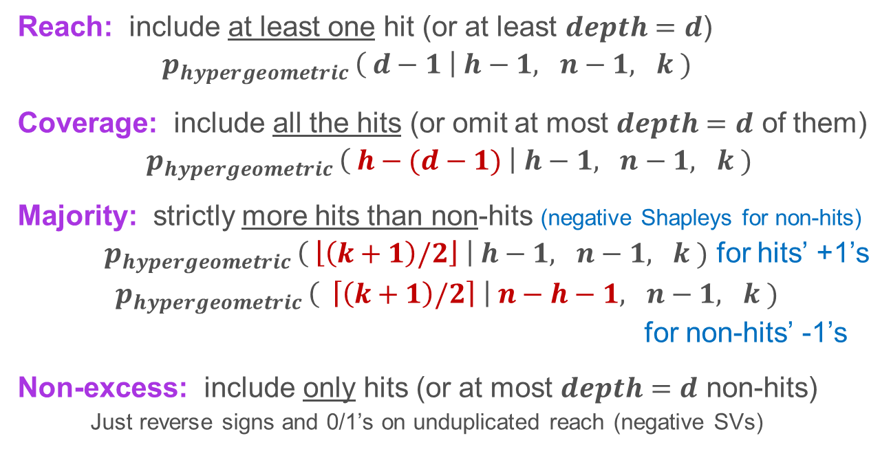
It’s Just for “Real” TURFs, Right? NO!
x
Reach: include at least one hit (or at least $depth=d$)
$p_{hypergeometric }\left( d−1 \right| h−1, n−1, k )$
Coverage: include all the hits (or omit at most $depth=d$ of them)
$p_{hypergeometric }\left( h−(d−1) \right| h−1, n−1, k )$
Majority: strictly more hits than non-hits (negative Shapleys for non-hits)
$p_{hypergeometric }\left( \left\lfloor \left(k+1\right)/2\right\rfloor \right| h−1, n−1, k )$ for hits’ +1’s
$p_{hypergeometric }\left( \left\lceil \left(k+1\right)/2\right\rceil \right| n−h−1, n−1, k )$
for non-hits’ -1’s
Non-excess: include only hits (or at most $depth=d$ non-hits)
Just reverse signs and 0/1’s on unduplicated reach (negative SVs)

Slide 28
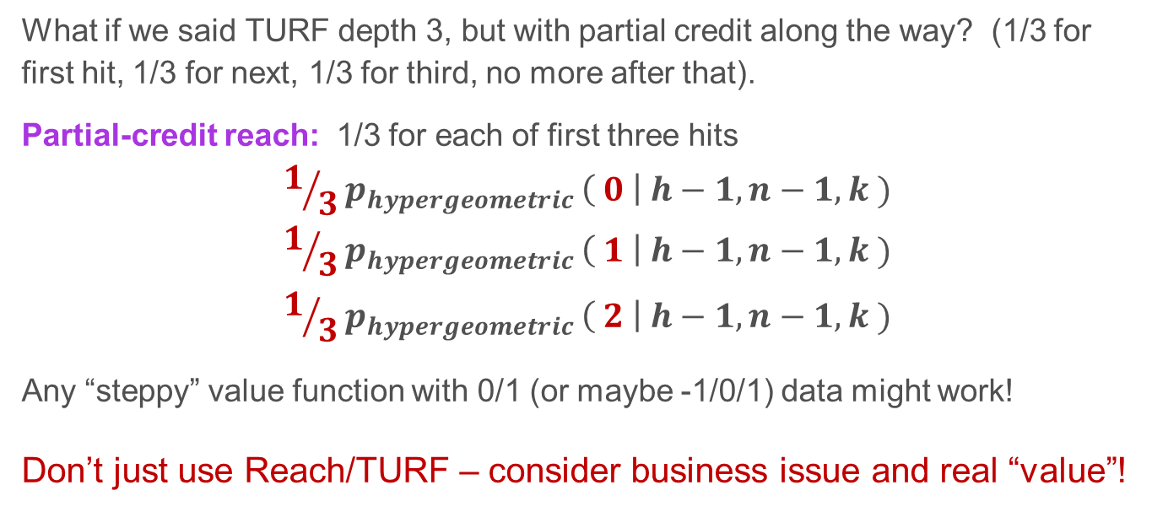
Not Just for “Real” TURFs!
What if we said TURF depth 3, but with partial credit along the way? (1/3 for
first hit, 1/3 for next, 1/3 for third, no more after that).
Partial-credit reach: 1/3 for each of first three hits
$$1/3p_{hypergeometric }\left( 0 \right| h−1, n−1, k )$$
$$1/3p_{hypergeometric }\left( 1 \right| h−1, n−1, k )$$
$$1/3p_{hypergeometric }\left( 2 \right| h−1, n−1, k )$$
Any “steppy” value function with 0/1 (or maybe -1/0/1) data might work!
Don’t just use Reach/TURF – consider business issue and real “value”!
+
+

Slide 29
Algebra Won’t Work? Use a Random Sample!
Not all value functions are “steppy”; not all data is simple nominal.
Easy answer: random sample of combinations of each size.
As we’ve seen, just have to average the averages for the different sizes together.
Works for any value function
More details in Appendix.

Slide 30
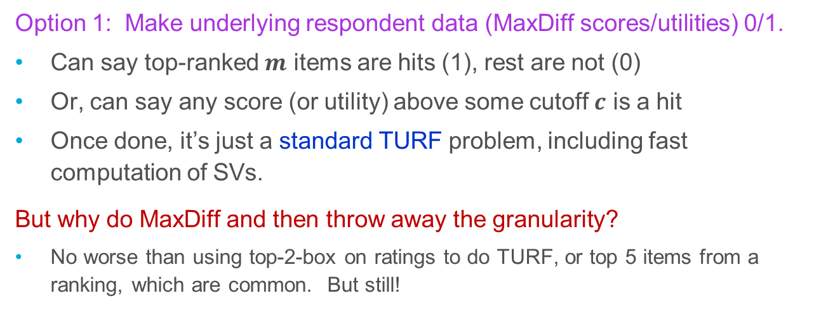
“TURF” and MaxDiff – How??
Option 1: Make underlying respondent data (MaxDiff scores/utilities) 0/1.
Can say top-ranked $m$ items are hits (1), rest are not (0)
Or, can say any score (or utility) above some cutoff $c$ is a hit
Once done, it’s just a standard TURF problem, including fast computation of SVs.
But why do MaxDiff and then throw away the granularity?
No worse than using top-2-box on ratings to do TURF, or top 5 items from a ranking, which are common. But still!

Slide 31
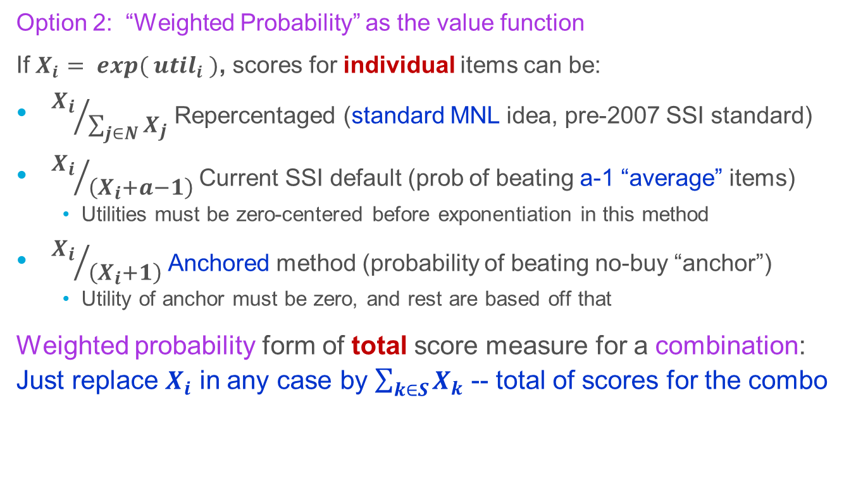
“TURF” and MaxDiff
x
Option 2: “Weighted Probability” as the value function
If $X_{i}$ $= exp⁡( {util}_{i}$ $)$, scores for individual items can be:
${X_{i}}/{\sum_{j∈N}{X_{j}}}$ Repercentaged (standard MNL idea, pre-2007 SSI standard)
${X_{i}}/{\left(X_{i}+a−1\right)}$ Current SSI default (prob of beating a-1 “average” items)
Utilities must be zero-centered before exponentiation in this method
${X_{i}}/{\left(X_{i}+1\right)}$ Anchored method (probability of beating no-buy “anchor”)
Utility of anchor must be zero, and rest are based off that
Weighted probability form of total score measure for a combination:
Just replace $X_{i}$ in any case by $\sum_{k∈S}{X_{k}}$ -- total of scores for the combo

Slide 32

“TURF” and MaxDiff with Weighted Probability
If using MNL total score rule, value function is strictly additive over items
SVs’ differencing exactly undoes the addition; SVs ≡ original item means!
(Same for standard TURF frequency: purely additive, so SVs ≡ means)
Other scores are not purely additive, so not so
No fast computation; enumerate or sample
MNL straight score
Wtd Prob Score for Combo
Anchored
$a−1$ average
But they’re not that far from linear!
Sum of Item Scores
Items
(MD scores)
Weight’d Prob’lity
Shapley Values
Items (SVs)
Combos
How much is really happening here?

Slide 33
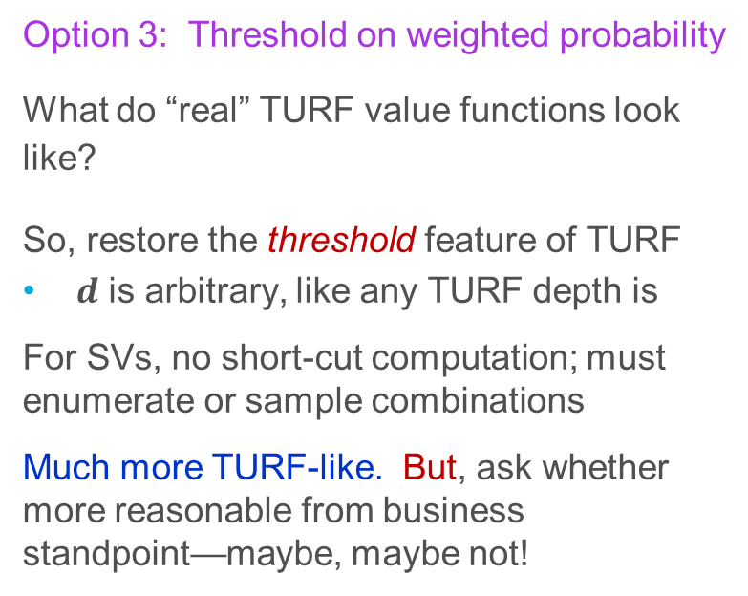

“TURF” and MaxDiff
Option 3: Threshold on weighted probability
What do “real” TURF value functions look like?
So, restore the threshold feature of TURF
$d$ is arbitrary, like any TURF depth is
For SVs, no short-cut computation; must enumerate or sample combinations
Much more TURF-like. But, ask whether more reasonable from business standpoint—maybe, maybe not!
MNL straight score
Wtd Prob Score for Combo
Anchored
Threshold $d$
$a−1$ average
Sum of Item Scores

Slide 34
Shapley Values!
Intuitive
Average contribution to a combination, weighting combo sizes equally (TURF and other common MR situations)
Averaging over orderings (KDRs or when focused on full set of items)
Useful
More compact, insightful, memorable overview than lists of combinations
Also more stable
Easy
Small problems are computationally easy
Fast & exact respondent-level calcs in some (many?) TURF-like cases
Sampling in reasonable time for large hard-algebra problems

Slide 35
Software Notes
R code for many of the basics discussed here is included in the handout zip file.
Like everything in R, use at your own risk. Study it first!
R package relaimpo (relative importance) does key-driver regression kinds of things with Shapley Values
R package turfR (Jack Horne) does TURF, but not Shapley Values.
Faster than my code for TURF, but at the cost of very high memory use, so for smaller problem sizes.
R package turf is not very useful.

Slide 36

Discussion
Lloyd Shapley, 1923-2016, in 2012

Slide 37
See Also
Michael Conklin and Stan Lipovetsky, “The Shapley Value in Marketing Research: 15 Years and Counting,” Proceedings of the 2013 Sawtooth Software Conference (downloadable online, free). It includes a good list of (more-rigorous, more-theoretical) other references.

